Slide 1
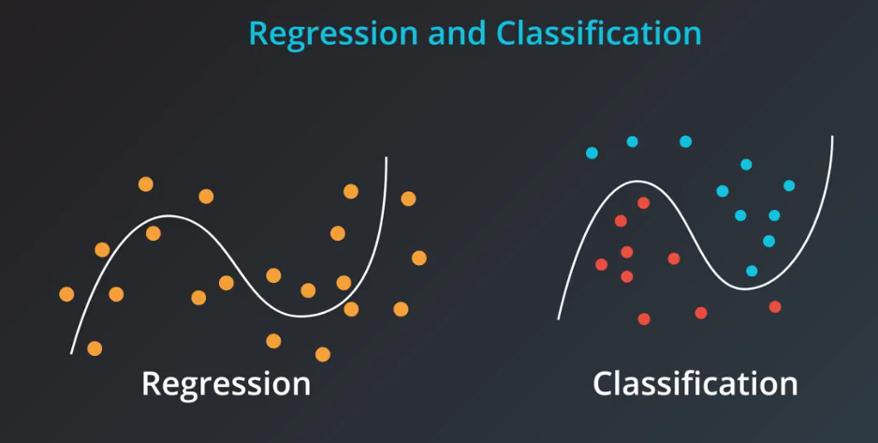
Regularizations are techniques used to generalize your model and reduce the error by fitting a function appropriately on the given training set and avoid overfitting.

Slide 2
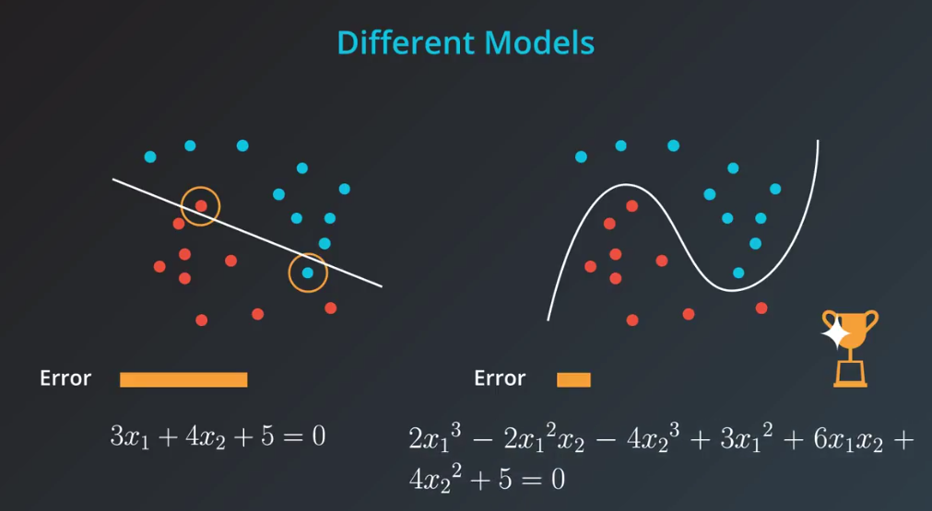

Slide 3
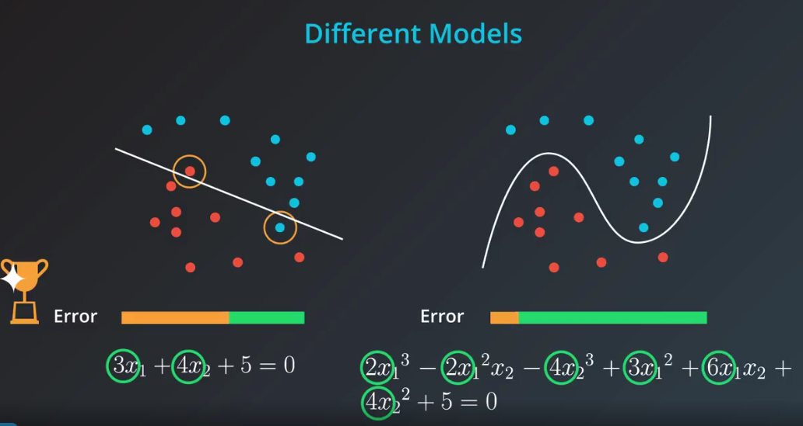
When adding complixity to the model

Slide 4
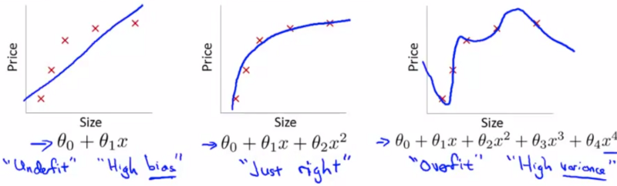
Overfitting with linear regression
Bias is a historic/technical one - if we're fitting a straight line to the data we have a strong assumption that there should be a linear fit
High variance - if fitting high order polynomial then the hypothesis can basically fit any data
, Space of hypothesis is too large
Generalization: This function of coefficients β1, β2 needs to be generalized by Regularization Parameter ‘λ’

Slide 5
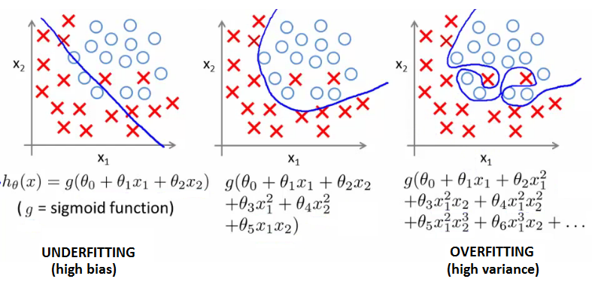
Overfitting with logistic regression
Sigmoidal function is an underfit
But a high order polynomial gives and overfitting (high variance hypothesis)

Slide 6
Overfitting Problem
If our model is suffer from Overfitting we can said that our model is a summarizing model than a predictive model.
Alternatively If our model is suffer from Underfitting we can say that our is not trained and consider be a random model.
Overfitting Problem Solving
Reduce number of features
Use Regularization Techniques

Slide 7
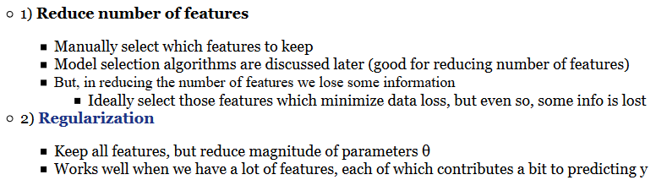
Overfitting Problem Solving

Slide 8
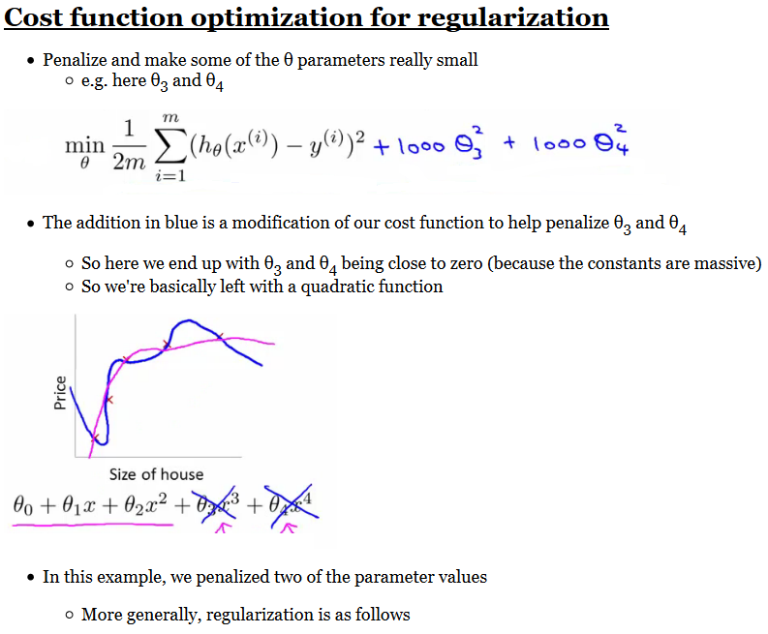

Slide 9


The regularization parameter λ
With regularization, take cost function and modify it to shrink all the parameters and Add a term at the end, This regularization term shrinks every parameter

Slide 10
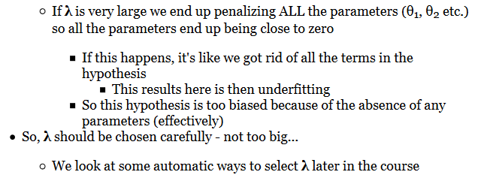
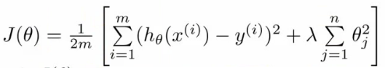
λ should be chosen carefully

Slide 11

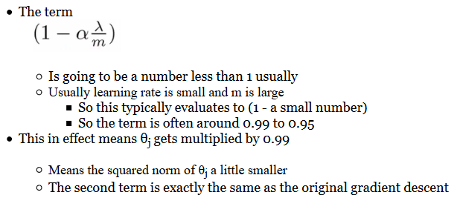
Automating λ

Slide 12
Regularization
Lasso Regression L1
Ridge Regression L2

Slide 13
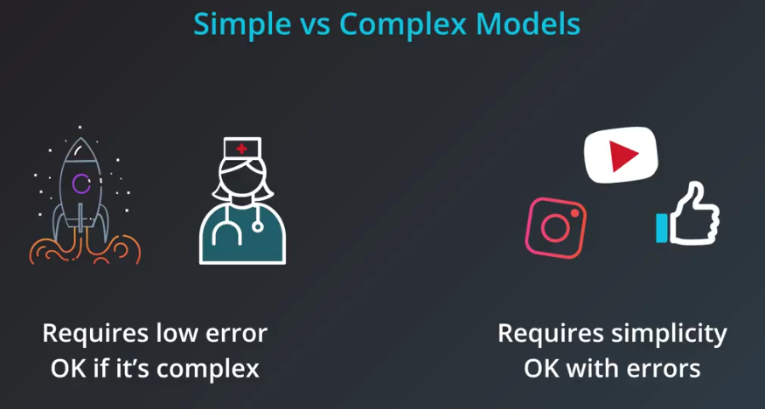

Slide 14
*
Use sklearn's Lasso class to fit a linear regression model to the data, while also using L1 regularization to control for model complexity.
Lasso Regression
LassoCV Regression
from sklearn.linear_model import Lasso
lasso_reg = Lasso()
lasso_reg.fit(X, y)
reg_coef = lasso_reg.coef_
from sklearn.linear_model import LassoCV
from sklearn.datasets import make_regression
X, y = make_regression(noise=4, random_state=0)
reg = LassoCV(cv=5, random_state=0).fit(X, y)
reg.score(X, y)
reg.predict(X[:1,])

Slide 15
Lasso Classification
LassoCV Classification
from sklearn.datasets import load_iris
from sklearn.linear_model import LogisticRegression
X, y = load_iris(return_X_y=True)
clf = LogisticRegression(penalty=’l1’ or ‘l2’, C=1.0).fit(X, y)
clf.predict(X[:2, :])
clf.predict_proba(X[:2, :])
clf.score(X, y)
from sklearn.datasets import load_iris
from sklearn.linear_model import LogisticRegressionCV
X, y = load_iris(return_X_y=True)
clf = LogisticRegression(penalty=’l1’ or ‘l2’, C=1.0).fit(X, y)
clf.predict(X[:2, :])
clf.predict_proba(X[:2, :])
clf.score(X, y)

Slide 16
*
Use sklearn's Ridge class to fit a linear regression model to the data, while also using L2 regularization to control for model complexity.
Ridge Regression
Ridge Classification
from sklearn.linear_model import Ridge
Ridge _reg = Ridge(alpha = 2.0)
Ridge _reg.fit(X, y)
reg_coef = Ridge _reg.coef_
from sklearn.datasets import load_breast_cancer
from sklearn.linear_model import RidgeClassifier
X, y = load_breast_cancer(return_X_y=True)
clf = RidgeClassifier().fit(X, y)
clf.score(X, y)

Slide 17
Ridge Regression
Ridge Classification
from sklearn.linear_model import Ridge
Ridge _reg = Ridge(alpha = 2.0)
Ridge _reg.fit(X, y)
reg_coef = Ridge _reg.coef_
from sklearn.datasets import load_breast_cancer
from sklearn.linear_model import RidgeClassifier
X, y = load_breast_cancer(return_X_y=True)
clf = RidgeClassifier().fit(X, y)
clf.score(X, y)
Ridge Regression with Cross Validation
Ridge Classification with Cross Validation
from sklearn.datasets import load_diabetes
from sklearn.linear_model import RidgeCV
X, y = load_diabetes(return_X_y=True)
clf = RidgeCV(alphas=[1e-3, 1e-2, 1e-1, 1]).fit(X, y)
clf.score(X, y)
from sklearn.datasets import load_breast_cancer
from sklearn.linear_model import RidgeClassifierCV
X, y = load_breast_cancer(return_X_y=True)
clf = RidgeClassifierCV(alphas=[1e-3, 1e-2, 1e-1, 1]).fit(X, y)
clf.score(X, y)

Slide 18
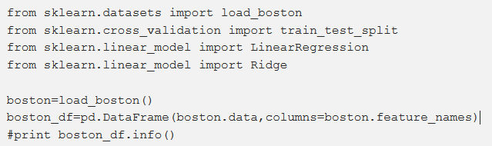
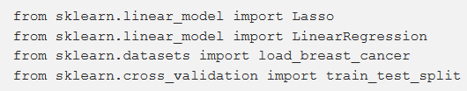



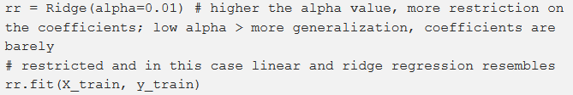
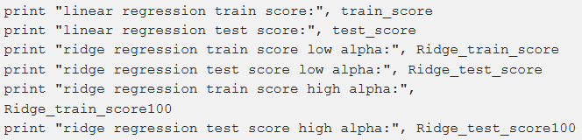
Notes:
https://towardsdatascience.com/ridge-and-lasso-regression-a-complete-guide-with-python-scikit-learn-e20e34bcbf0b

Slide 19



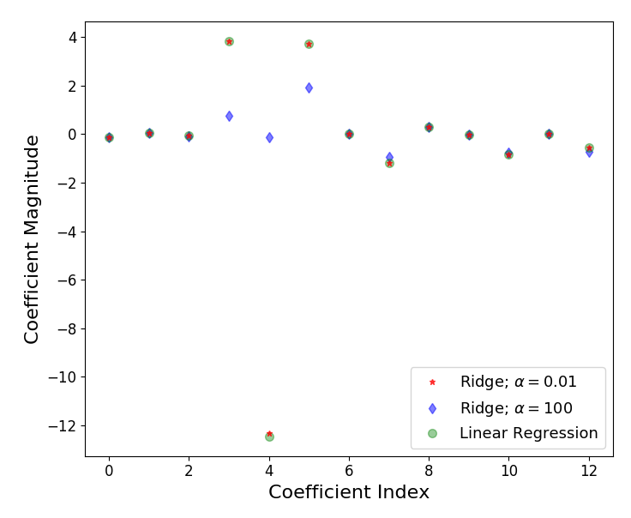

Slide 20

Ai Simplification Series
Regards

